Slide 1
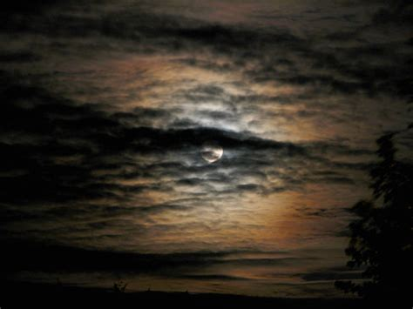
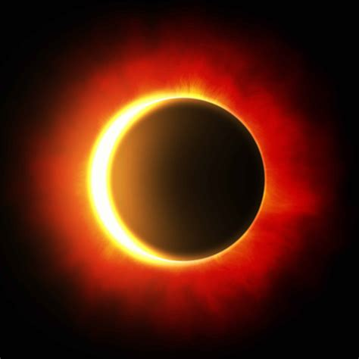
Eclipses – Page 1
Do you know the game "peek-a-boo"? It's like that, but way up in the sky! An eclipse is a fascinating event when one celestial body, such as the moon or Earth, sneaks into the shadow of another. It's just like when you stand in front of a friend, and they can't see their favourite TV show! Out in space, we have two main types of these events: solar and lunar. In a solar eclipse, the cheeky moon blocks our view of the sun. But in a lunar eclipse, the Earth's big shadow gently falls on the moon, making it look mysterious.
What does your brain act like when it learns? ___________________________________________________________________
What are the tiny connections in your brain called? ___________________________________________________________________
What do these tiny connections help you do? ___________________________________________________________________
Imagine the moon wearing sunglasses because the sun's too bright! That's a solar eclipse for you. The moon slides between Earth and the sun. Suddenly, day feels like night for a brief moment. Everything cools down a bit. But remember, don't look straight at the sun during this time! It's so bright it could harm your eyes. Always peek through special glasses or a safe viewer.
Who moves between the Earth and sun during a solar eclipse? ___________________________________________________________________
What happens to the day during a solar eclipse? ___________________________________________________________________
Why does it get cooler during a solar eclipse? ___________________________________________________________________

Slide 2
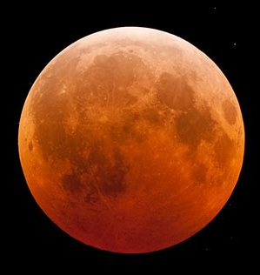
Eclipses – Page 2
Picture the moon getting a big, dark hug from Earth's shadow! That’s a lunar eclipse. It happens when Earth stands between the sun and moon. Sometimes, the moon turns reddish, earning the nickname "Blood Moon". It's a breathtaking view, and the coolest part? You can gaze at a lunar eclipse safely with your eyes, no special equipment needed!
What gives the moon a “big, dark hug”? __________________________________________________________________
Who stands between the sun and moon during a lunar eclipse? __________________________________________________________________
What colour might the moon turn during this event? __________________________________________________________________
You've just learned about the magical game of "peek-a-boo" in the sky. Now, imagine you're a director of a movie about eclipses. Draw or write a storyboard of your movie. Include the main characters, their adventures, and the cool things they discover about solar and lunar eclipses. Remember, your movie should teach others about eclipses too! How would you make it both fun and educational? Get creative and have fun!

